Slide 1
Credit Card Fraud Detection
A Data Analytics Project
Akshatha B

Slide 2
Introduction
Fraud detection is crucial in the financial sector.
The goal is to identify fraudulent transactions using machine learning techniques.

Slide 3
Problem Statement
Class imbalance: Only 0.17% of the transactions are fraudulent.
Traditional methods are not effective in identifying rare fraud cases.

Slide 4
Dataset Overview
Source: Kaggle – Credit Card Fraud Dataset
Total records: 284,807
Features: 30 (V1–V28, Time, Amount)
Target: Class (0 – legit, 1 – fraud)

Slide 5
Tools Used
Python
Libraries: Pandas, NumPy, Seaborn, Matplotlib, Scikit-learn
IDE: VS Code / Jupyter Notebook

Slide 6
Data Preprocessing
Checked null values
Scaled features (if used)
Handled class imbalance using SMOTE

Slide 7
Class Distribution
0 → 284,315 transactions
1 → 492 transactions
Only 0.17% are fraud (Add pie chart or bar chart if possible)

Slide 8
Model Building
Split data: 70% train, 30% test
Used models like:
Logistic Regression
Decision Tree
Random Forest
Focused on recall & precision due to imbalance

Slide 9
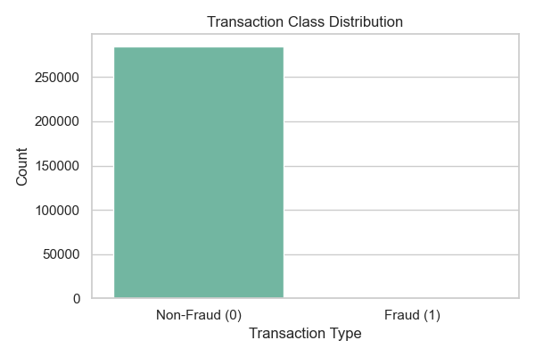
Evaluation Metrics
Confusion matrix
Accuracy, Precision, Recall, F1-score

Slide 10
Conclusion
Fraud detection is challenging due to class imbalance
Machine learning helps identify patterns
Random Forest gave the best performance

Slide 11
Future Work
Try deep learning (e.g., Neural Networks)
Real-time fraud detection system
Use advanced sampling or anomaly detection methods

Slide 12
Thank You
Questions?
Contact: akshuuhhh@gmail.com

